Slide 1

MAEER’s
MIT COLLEGE OF RAILWAY ENGINEERING AND RESEARCH
BARSHI-413401
Project Phase-I Idea Presentation on
“Mess Management System”
Presented By
1.Mahesh Madane
2.Siddhi Kulkarni
3.Dinesh Garule
4.Amruta Kore
Guide
Prof . Srushti Raut

Slide 2
Contents
Introduction
Literature Survey
Motivation and Objectives
Problem Statement
Requirements : Hardware and Software
Proposed Work
Algorithms
Conclusion
References

Slide 3
Introduction
The Smart Mess Management System is a web-based application designed to streamline and modernize mess operations at MIT. It provides an intuitive platform for students and administrators to manage meal planning, attendance, feedback, and communication efficiently.
Built with a modern tech stack—React and Tailwind CSS for the frontend, Django REST Framework for the backend, and SQLite for the database—the system features a responsive, multilingual interface with light/dark mode support, Font Awesome icons, and a user-friendly design.
Key functionalities include real-time meal tracking, snack board management, rule display, staff directory, feedback submission, and a gallery for events.

Slide 4
Literature Review
Sr. No | Paper Tile | Paper concept | Advantage | Disadvantage
1 | Pandey, S., Quraishi, R., Salian, A., & Bhagat, S. (2024). Development and evaluation of a comprehensive web-based canteen food ordering system. IJRASET, DOI: 10.22214/ijraset.2024.65046. | The paper presents a web-based food ordering system for canteens that allows users to browse menus, place orders, and make digital payments. | Reduces long queues and wait times in canteens. | Requires constant internet access for users and staff. System performance depends on server capacity.
2 | Justine, M. (2024). Web-based canteen management system: A case study of Uganda Martyrs University. BSc Dissertation (UMU). | Focuses on improving communication between students and canteen operators. | Simplifies management tasks and reduces manual errors. Provides real-time menu updates and sales reporting. | Limited scalability for larger institutions without further optimization.

Slide 5
3 | Goud, C. S., Reddy, M. H., Sultana, N. M., & Sreekala, K. S. (2020). QuickDine: An Efficient Canteen Management System. Journal of Network Security and Data Mining | Integrates inventory management and order analysis modules for admins. | Real-time order tracking improves service transparency. Inventory management prevents overstocking and understocking. Reduces labor dependency through automation. | May require high maintenance for real-time services. May not support integration with other institutional systems

Slide 6
Motivation
In many hostels and college campuses, mess operations are still managed manually through registers, paper-based attendance, and outdated billing methods. This leads to common issues such as food wastage, inaccurate billing, lack of proper records, and minimal student involvement or feedback. As students ourselves, we have personally experienced the inconvenience and inefficiencies of such systems. These challenges inspired us to build a Mess Management System that can simplify daily mess operations using technology.
Our motivation is to create a platform that not only reduces the workload of mess administrators but also gives students more control and clarity over their mess-related activities. By integrating features like digital attendance, live menus, automated billing, and feedback systems, we aim to enhance the overall dining experience, improve food planning, and bring transparency to the system. This project also serves as an opportunity to apply fullstack development skills to solve a real-world problem faced by thousands of students daily.

Slide 7
Objectives
Streamline mess operations at MIT by automating meal tracking and attendance.
Enhance user experience with a responsive, multilingual interface supporting English, Hindi, and Marathi.
Reduce food wastage through real-time menu planning and feedback analysis.
Improve communication between students and staff via centralized features like rules and notes board.
Ensure scalability and reliability using Django REST Framework and React with a modern UI.

Slide 8
Problem Statement
The current mess system at MIT is manual and inefficient, leading
to errors in meal tracking, attendance, and feedback. Students lack real-time access to menus and updates, causing confusion. Poor planning results in food wastage, and communication between students and staff is scattered. There's a clear need for a centralized, automated, and user-friendly solution to improve efficiency and user experience.

Slide 9
Proposed System
The Smart Mess Management System is a modern, web-based solution
developed to improve and automate the mess operations at MIT, replacing
traditional manual methods.
The platform uses a React + Tailwind CSS frontend for a responsive and multilingual user experience (English, Hindi, Marathi), along with a Django REST Framework backend and SQLite database for efficient data management.
The system supports essential features such as:
Real-time meal tracking
Feedback submission with comment support
Menu and snack board management
Mess rules display
Staff directory access

Slide 10
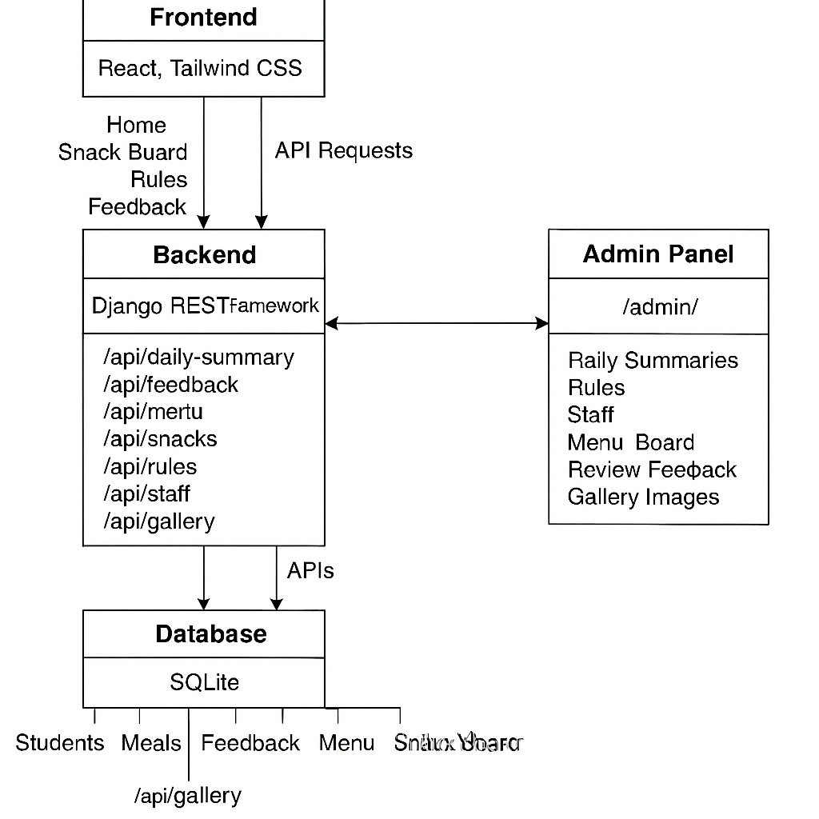
System Architecture
Snack Board

Slide 11
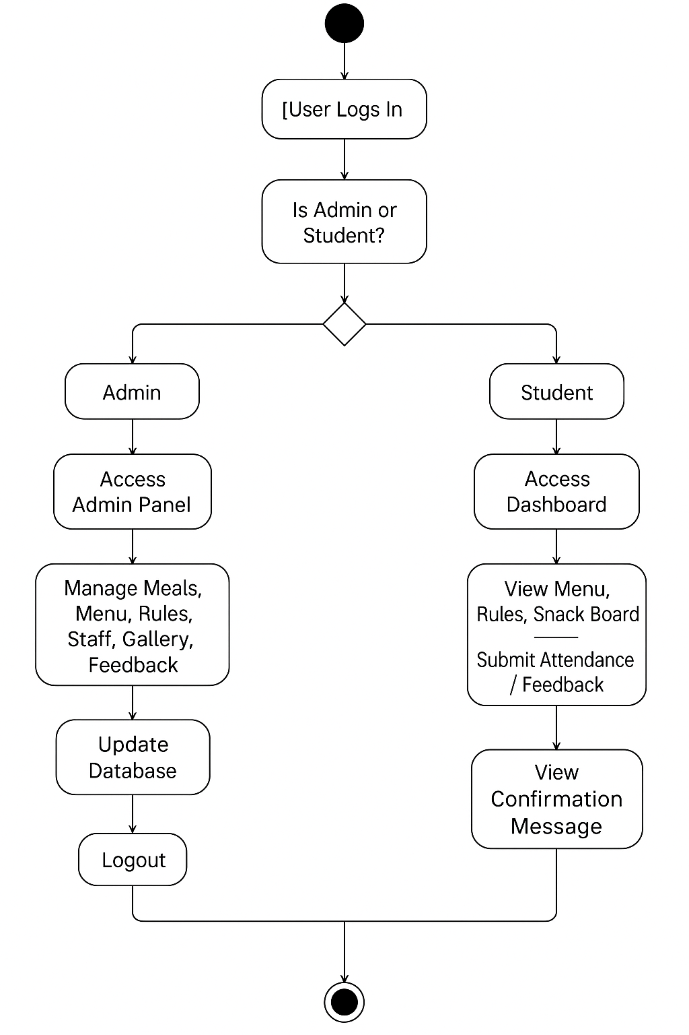
Basic flow of system

Slide 12
Algorithms
1. Start
2. User logs in with credentials
3. Check user role:
a. If Admin:
- Redirect to Admin Dashboard
- Admin can:
i. Add/Update/Delete Meals
ii. Manage Menu & Snack Board
iii. Upload Gallery Images
iv. View and manage Feedback

Slide 13
v. Edit Rules and Staff Info
- All changes update the backend via APIs
b. If Student:
- Redirect to Student Dashboard
- Student can:
i. View Menu, Rules, Snacks, Gallery
ii. Mark Attendance
iii. Submit Feedback
4. API requests from frontend communicate with Django backend
5. Backend processes data and updates SQLite database
6. Feedback or success message is returned to the user
7. User logs out
8. End
23

Slide 14
Conclusion
The Smart Mess Management System offers a modern, efficient, and user-friendly solution to the challenges faced by traditional mess operations at MIT.
By leveraging a robust tech stack—React and Tailwind CSS on the frontend, Django REST Framework with SQLite on the backend—it automates key processes such as meal tracking, feedback collection, menu planning, and staff coordination.
The system significantly improves:
Efficiency through automation of manual tasks
User experience with a clean, responsive, multilingual interface
Communication via centralized rule display, staff directory, and real-time updates
Sustainability by reducing food wastage through data-driven planning

Slide 15
References
Pandey, S., Quraishi, R., Salian, A., & Bhagat, S. (2024). Development and evaluation of a comprehensive web-based canteen food ordering system. IJRASET, DOI: 10.22214/ijraset.2024.65046.
Justine, M. (2024). Web-based canteen management system: A case study of Uganda Martyrs University. BSc Dissertation (UMU).
Auti, P., Bawankar, M., Bochare, P., Harane, V., & Rajgure, N. K. (2023). A review on smart canteen management system. IJRASET. DOI: 10.22214/ijraset.2023.56698.
Goud, C. S., Reddy, M. H., Sultana, N. M., & Sreekala, K. S. (2020). QuickDine: An Efficient Canteen Management System. Journal of Network Security and Data Mining.

Slide 16
THANK YOU!

